Slide 1
Welcome to the Tennis Parent meeting!
Please be patient as I let everyone in the meeting. Type your daughters name in the “Chat” so that I know who received this presentation.
**Ask your daughter for the packet I handed out today and keep that close. I will go over these pages.

Slide 2
A little about Coach McCombs…
Started playing tennis in 7th grade.
Played volleyball, basketball, and tennis in High School.
Attended Lee College (tennis scholarship). Won nationals.
Attended University of Houston (tennis scholarship).

Slide 3
Sign up for remind
Text this number… 81010
Message: @wistenni
Both athlete and parent please sign up

Slide 4
Stapled Packet to turn in
Tennis Handbook
Spirit Shirt
Alternative travel form: Put any adult driving your child home after the match on the “Adult Driver Name”. Guardian must sign this form
UH Field Trip consent form
Booster Club- if you have already joined- you can tear this paper off.
Schedule- yours to keep

Slide 5
T-shirt design
Short sleeve
Cotton shirt
$20
Cash or check (phone number),
Checks- made out to WIS
Order your shirt by Feb 23
(send me sizes ASAP, money can come later)

Slide 6
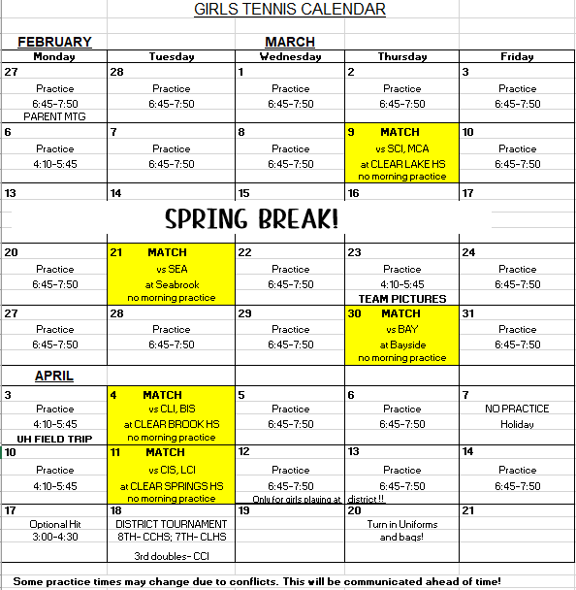
Schedule

Slide 7
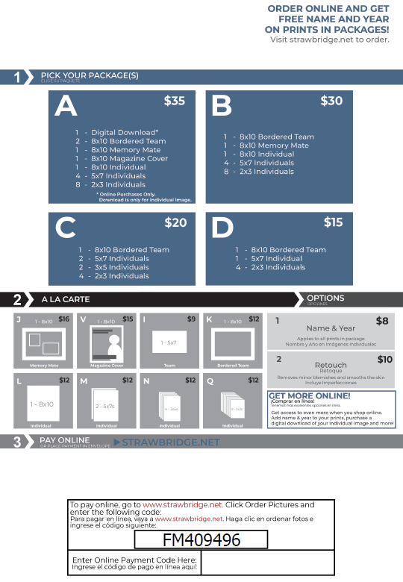
Team Pictures
March 23rd : after school
Come dressed in your uniform
Practice after until 5:45
More details to come!
https://strawbridge.fotomerchanthv.com/clients/westbrook-intermediate-school/sports-pictures-3-23-2023-5/optIn

Slide 8
Morning Doors
The doors will open at 6:30, and close at 6:45 due to safety reasons.
If you are late, then you take time away from everyone else for me to go open the doors. Don’t be late. ☺

Slide 9
Missing Practice:
You need to send a remind message or email BEFORE practice if you will not be there. Practice is mandatory, you need to attend.
I make practice plans for each practice, and I plan for everyone to attend each day.
Please be on time to each practice! We only have so much time on court.
If you take lessons after school on a certain day, please communicate ahead of time what days those are and you will be excused.

Slide 10
What to wear: practice/matches
Monday-Thursday: Red/grey/white/black shirt and shorts/skirt
Friday: Your choice of clothes
Dress weather appropriately. Some days are SUPER COLD. Dress in layers.
We will be outside if the courts are dry.
Uniform at matches: I will pass out a red tennis shirt.
Black bottoms are to be worn. I encourage pockets in shorts, or spandex under skirts to put the tennis balls in. I have a few black skirts. You can wear your own! Needs to be all black.
Tennis shoes are not required but highly encouraged.
Academy, Racket pro, tennis express, online all carry them.

Slide 11
Matches
Top player- Singles line 1
Second best player- Singles line 2
3rd/4th best player- Doubles line 1
5th/6th best player- Doubles line 2
7th /8th best player- Doubles line 3
9th /10th best player- Doubles line 4
11th/12th best player- Doubles line 4
When one match comes off, the next one goes on.
When your match is over, you are free to leave.

Slide 12
Matches continued…
Singles will play a set- no ad scoring
Doubles lines 1 and 2 will play a set- no ad scoring
Doubles line 3, 4, and 5 will play first to 4
When both schools are at the match- we begin play immediately.
You must sign-out after your match on away matches. There will be a sign-out clipboard on the fence.
Not everyone will play every match. Some will play 2 matches. (This depends on how many our opponents bring)
Please plan to pick your child up after each match. No bus will go back to Westbrook.

Slide 13
District Tournament
Singles Line 1, Singles Line 2, Doubles Line 1, Doubles Line 2, Doubles Line 3 are the only players to play at district.
Your goal all season is to be in the top 8 and play at district.
Starts around 3:00… girls will get out early from school. Lots more information will be provided closer to this date. Tuesday April 18th

Slide 14
Snacks
In the past, we have had parents bring after school snacks and drinks for the team.
Please email or remind text Coach McCombs if you would like to donate.

Slide 15
Parent Etiquette
No coaching from the sidelines.
Let the players make their own calls. (Yes- sometimes it’s bad! ☺)
If there is an issue, I teach the girls to stop play and come find me. If something is not resolved, then parent can come find me.
You can clap and cheer after the point is over.
Tennis is a “quiet” sport as compared to most other sports.

Slide 16
Field Trip to UH Tennis Match
Monday April 3rd
We will leave Westbrook at 9:00am and return by 2:00pm
Bring money for chick-fil-a lunch or bring a sack lunch
More details to come

Slide 17
End of Season Party
We have a student/faculty tennis tournament to celebrate the end of the season. More information will come later in the year for this.

Slide 18
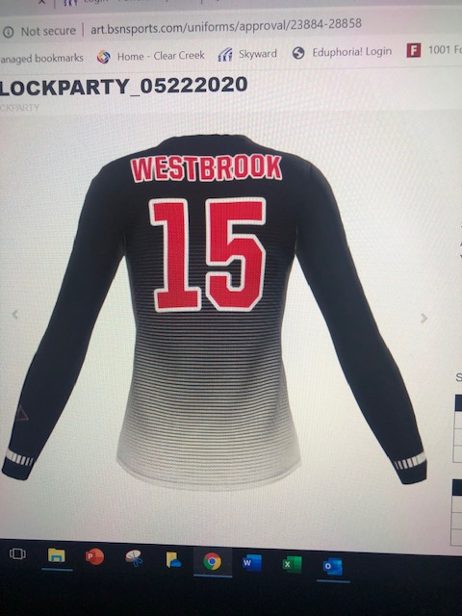
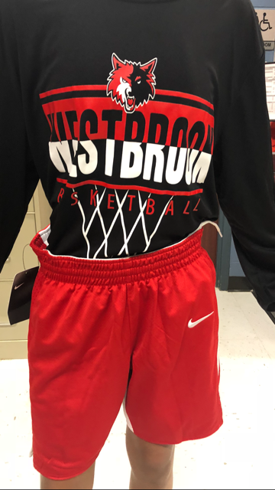
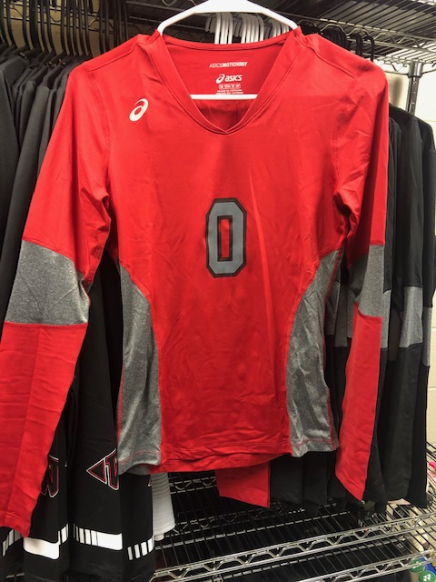
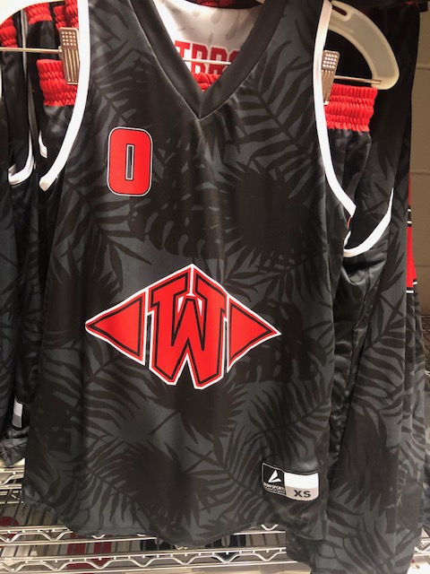
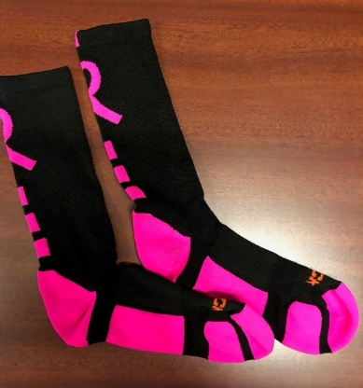
Booster Club
President- Whitney Maples
Booster club supports the girl's athletic program 100%.
Large reason we can have our end of year lock-in celebration.
District Lunch meal
Please consider joining today!

Slide 19
Checklist:
Sign up for remind
Order spirit shirt
Join booster club
Turn in stapled packet
Email Coach McCombs to bring snacks/drinks

Slide 20
Any questions??
THANK YOU for being here tonight!
I am looking forward to a great and successful season!

